Slide 1

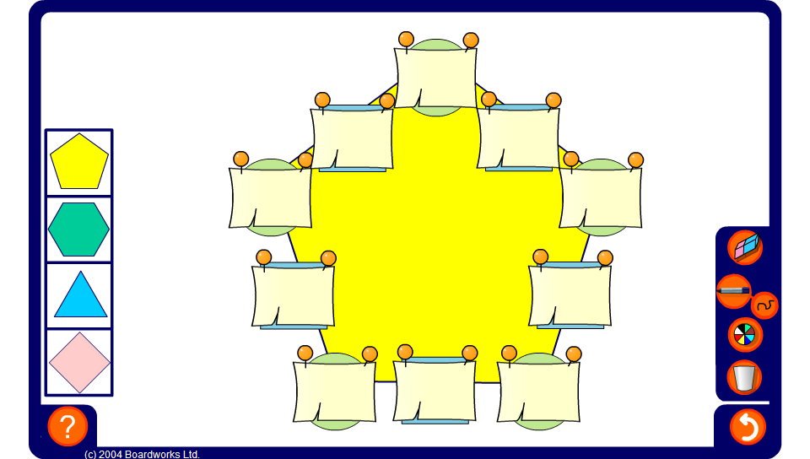


Productagons – using times tables
Notes:
Explain to pupils that in this puzzle the numbers inside the squares are equal to the product of the two circles on either side.
Use the productagon on this slide to practise multiplying and dividing by whole numbers between 2 and 12. Press reset for a new puzzle or change the shape of the puzzle by selecting one of the shapes on the left.
To practise multiplying, only reveal the numbers inside the circles.
To practise dividing, reveal some numbers inside the squares and some of the numbers inside the circles.

